Slide 1
Dynamically Generating Study Monitoring Reports via Email
Eric M. W. Fischer, John Hepler, Sarah A. Gaussoin, Mark Espeland, and Suzanne Craft
Department of Internal Medicine - Gerontology | Department of Biostatistics and Data Science

Slide 2
Disclosures:
Nothing to disclose

Slide 3
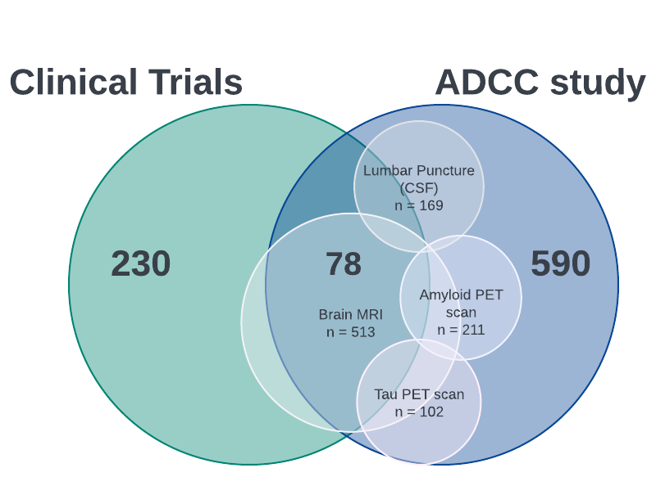
WAKE FOREST ADRC
NACC ADRC & Clinical Trials
ADRC since 2016
15 clinical trials
Data:
Cognitive status (NC, MCI, PD)
Behavior & mood questionnaires
Biospecimens (Blood & CSF)
Imaging: Brain MRI, Amyloid PET Scan, Tau PET Scan
Brain Donation

Slide 4
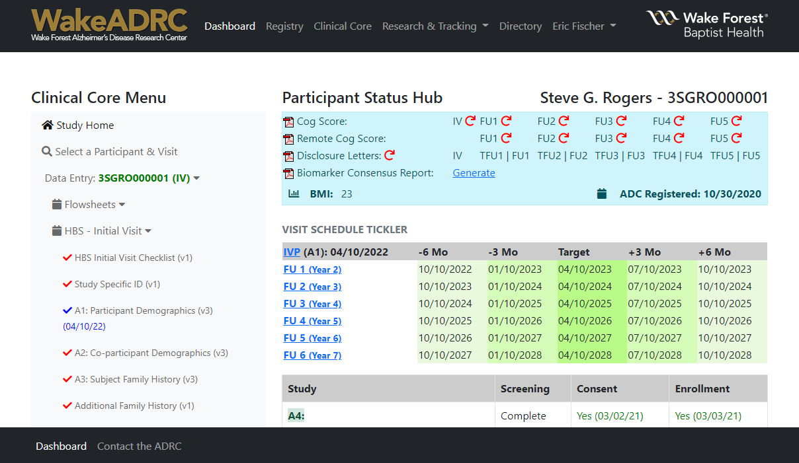
WAKEADRC WEBSITE
Record recruitment sources
Track consent, screening, and enrollment across studies
Record study data and visit completion tracking
Generate disclosure/feedback letters based on data entry

Slide 5
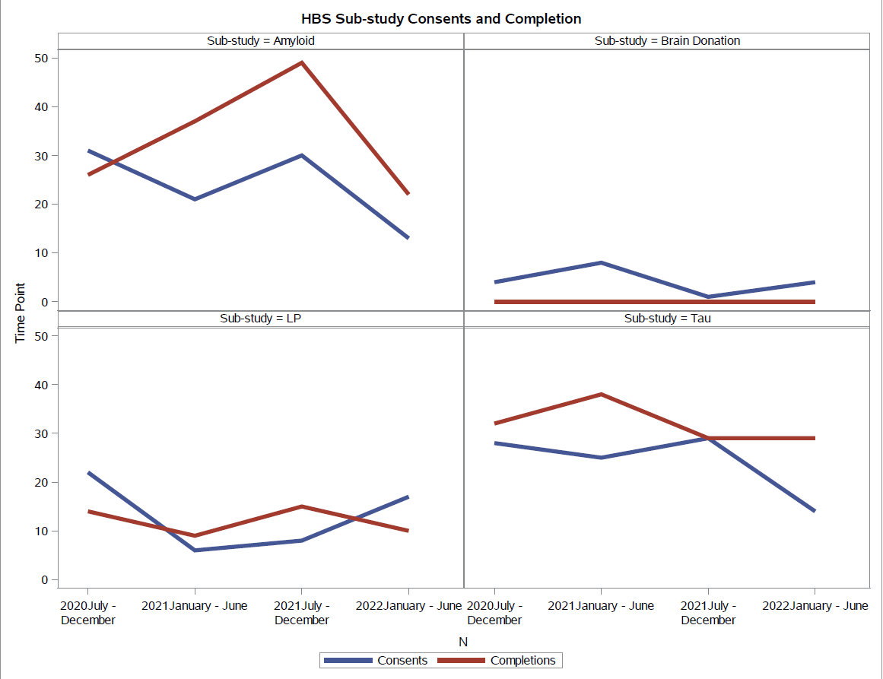
SAS REPORTS
Real-time reports:
Recruitment sources
Screening & enrollment status
Retention and attrition rates
Data Completion reports
Reports interpreting cognitive outcomes

Slide 6
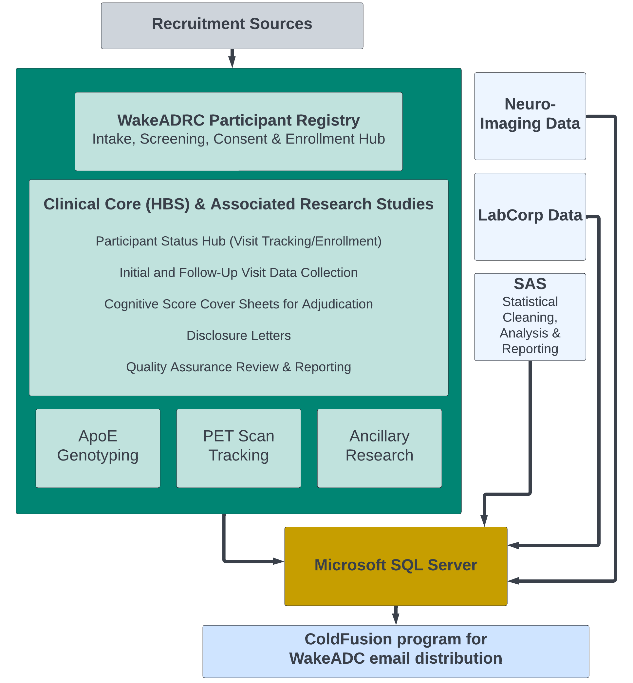
PIPELINE

Slide 7
PROCESS:
SQL Server
robots.txt
Server Admin Tool
Reports
Cross-form validation, and DE warnings/errors.
Consensus on reports to be distributed
Schedule task directory, fires page at scheduled time
Prevent spam emails and to protect the servers

Slide 8
DYNAMIC STUDY MONITORING REPORTS :
ColdFusion program written to automatically distribute two emails:
Weekly Email
Biannual Email
Tables to monitor volume:
ADCC Active Enrollment Demographics
Recruitment Summary – Enrolled Participants
Ineligibility Demographics & Reason
M1 Tracking – Milestone form
PET/LP/BD Enrollments & Counts
2-year plots:
Withdrawals & Lost to Follow-Up
Participant deaths
Visit completion
Enrollment by Current Dx & Race/Ethnicity
Sub-study consent and completion

Slide 9
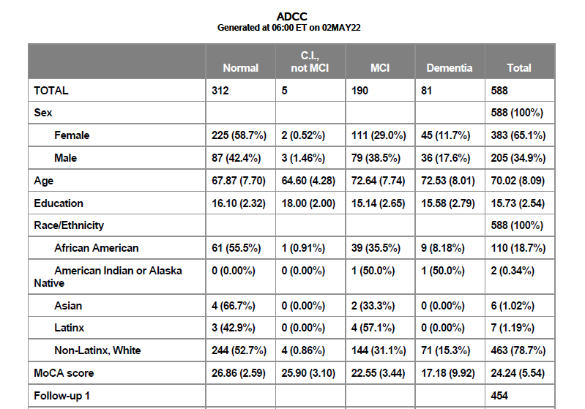
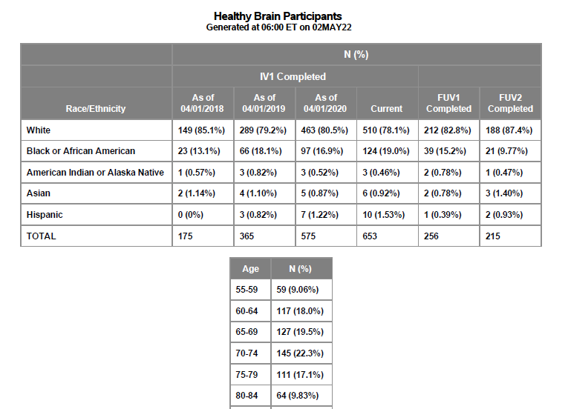
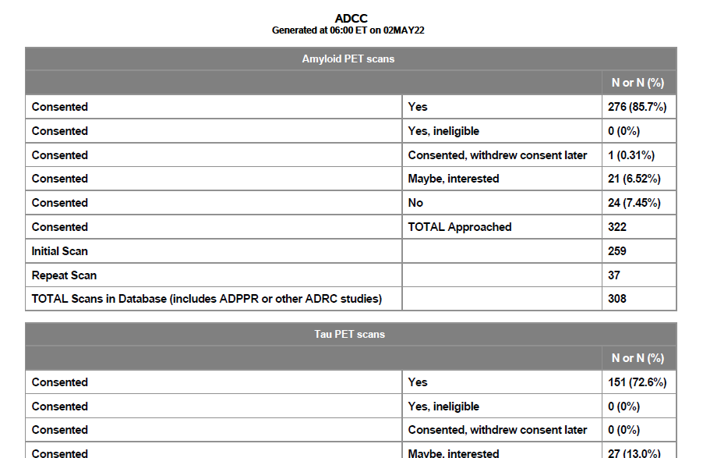
EMAIL CONTENT
Sent to Center’s Director, PIs, and site managers
Includes the report’s title and a description of content
Data team cc’d for responses or questions

Slide 10
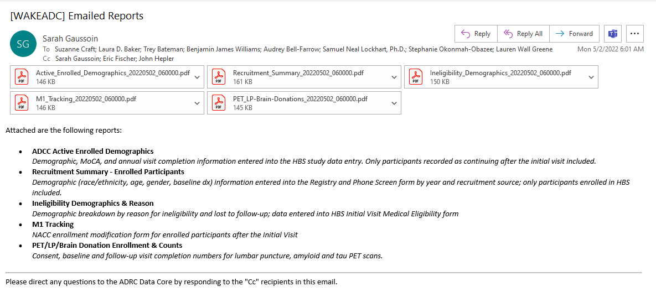
WEEKLY EMAIL REPORT

Slide 11
BENEFITS
Cross-study measurements
Communication
Data QC/QA

Slide 12
NEXT STEPS
Monitor reports
Patient safety

Slide 13
Thank you!

